Slide 1
Writing a literature review
Professional Practice 3
N. Wessels

Slide 2
Definition
A literature review is a critical analysis of the literature, or research, related to a specific topic or research question. A literature review synthesizes and evaluates the relevant scholarship on a particular topic, usually one that is fairly narrow in scope. A literature review does not contain any new research, but rather is an overview and critique of work that already has been published. Forms of this kind of essay are used in almost every field across the natural sciences, social sciences, and humanities.
*synthesize: to combine a number of things into a coherent whole/ to combine different things in order to make something new. *evaluate: to judge how good, useful or successful something is/ when you evaluate something, you are making a judgment, one that most likely results from some degree of analysis. *scholarship: academic study or achievement, learning at a higher level/ serious, detailed study, for example: a work of great scholarship.

Slide 3
Definition
A literature review is a survey of scholarly sources on a specific topic. It provides an overview of current knowledge, allowing you to identify relevant theories, methods, and gaps in the existing research. Writing a literature review involves finding relevant publications (such as books and journal articles), critically analyzing them, and explaining what you found.

Slide 4
Why write a literature review?
When you write a thesis, dissertation, or research paper you will have to conduct a literature review to situate your research within existing knowledge. A literature review can therefore appear as a chapter or section in a bigger research report/proposal/thesis. It helps provide context and rationale for the research. The literature review gives you a chance to: - Demonstrate your familiarity with the topic and scholarly context; - Develop a theoretical framework and methodology for your research; - Position yourself in relation to other researchers and theorists; - Show how your research addresses a gap or contributes to a debate. You might also have to write a literature review as a stand-alone assignment. In this case, the purpose is to evaluate the current state of research and demonstrate your knowledge of scholarly debates around a topic. The content will look slightly different in each case, but the process of conducting a literature review follows the same steps.

Slide 5
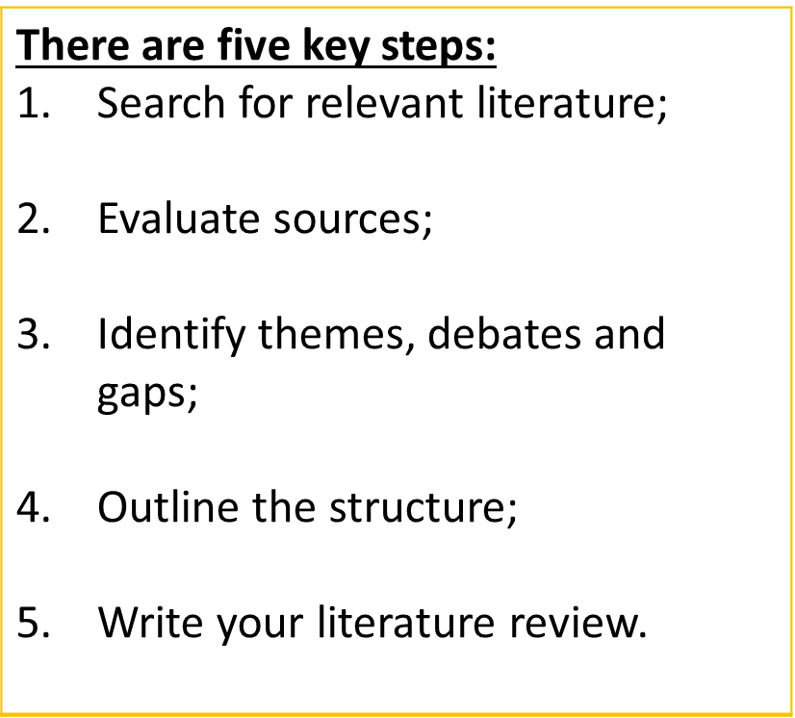
Writing a literature review

Slide 6
Step 1: Search for relevant literature
Before you begin searching for literature, you need a clearly defined topic. If you are writing the literature review section of a dissertation or research paper, you will search for literature related to your research problem and questions. If you are writing a literature review as a stand-alone assignment, you will have to choose a focus and develop a central question to direct your search. Unlike a dissertation research question, this question has to be answerable without collecting original data. You should be able to answer it based only on a review of existing publications.

Slide 7
Step 1: Search for relevant literature
1.1. Clearly define your topic
1.2. Make a list of keywords
Start by creating a list of keywords related to your research question. Include each of the key concepts or variables you’re interested in and list any synonyms and related terms. You can add to this list if you discover new keywords in the process of your literature search.
Keywords example
Social media, Facebook, Instagram, Twitter, Snapchat, TikTok
Body image, self-perception, self-esteem, mental health
Generation Z, teenagers, adolescents, youth

Slide 8

Step 1: Search for relevant literature
1.3. Search for relevant sources
Use your keywords to begin searching for sources. Some useful databases to search for journals and articles include:
Your university’s library catalogue - https://www.cput.ac.za/lib Google Scholar JSTOR EBSCO Project Muse (humanities and social sciences) Medline (life sciences and biomedicine) EconLit (economics) Inspec (physics, engineering and computer science)

Slide 9
Step 1: Search for relevant literature
1.3. Search for relevant sources continued…
You can use Boolean operators to help narrow down your search:
Read the abstract to find out whether an article is relevant to your question. When you find a useful book or article, you can check the bibliography to find other relevant sources.
To identify the most important publications on your topic, take note of recurring citations. If the same authors, books or articles keep appearing in your reading, make sure to seek them out.
AND to find sources that contain more than one keyword (e.g. social media AND body image AND generation Z OR to find sources that contain one of a range of synonyms (e.g. generation Z OR teenagers OR adolescents) NOT to exclude results containing certain terms (e.g. apple NOT fruit)

Slide 10
Step 2: Evaluating your sources
After you have found a number of articles or books related to a topic, you must evaluate them to determine which ones seem to make the most important contributions to the scholarship on the topic.
For undergraduate students, this step is often difficult since they are not experts and are just beginning to learn about major themes and debates within a field.
For guidelines on determining the credibility on information and the information’s source, refer to your Prof Comm 2 Critical Thinking notes: Evaluating information and the information’s source.

Slide 11
Step 2: Evaluate your sources
You probably won’t be able to read absolutely everything that has been written on the topic – you’ll have to evaluate which sources are most relevant to your questions.
For each publication, ask yourself:
What question or problem is the author addressing? What are the key concepts and how are they defined? What are the key theories, models and methods? Does the research use established frameworks or take an innovative approach? What are the results and conclusions of the study? How does the publication relate to other literature in the field? Does it confirm, add to, or challenge established knowledge? How does the publication contribute to your understanding of the topic? What are its key insights and arguments? What are the strengths and weaknesses of the research?

Slide 12
Step 2: Evaluate your sources
Make sure the sources you use are credible, and make sure you read any landmark studies and major theories in your field of research. You can find out how many times an article has been cited on Google Scholar – a high citation count means the article has been influential in the field, and should certainly be included in your literature review. The scope of your review will depend on your topic and discipline: in the sciences you usually only review recent literature, but in the humanities you might take a long historical perspective (for example, to trace how a concept has changed in meaning over time).
Take notes and cite your sources: As you read, you should also begin the writing process. Take notes that you can later incorporate into the text of your literature review. It is important to keep track of your sources with citations to avoid plagiarism. It can be helpful to make an annotated bibliography, where you compile full citation information and write a paragraph of summary and analysis for each source. This helps you remember what you read and saves time later in the process.

Slide 13
Step 3: Identify themes, debates, and gaps
To begin organizing your literature review’s argument and structure, you need to understand the connections and relationships between the sources you’ve read. Based on your reading and notes, you can look for:
This step will help you work out the structure of your literature review and (if applicable) show how your own research will contribute to existing knowledge.
Trends and patterns (in theory, method or results): Do certain approaches become more or less popular over time? Themes: What questions or concepts recur across the literature? Debates, conflicts and contradictions: Where do sources disagree? Pivotal publications: Are there any influential theories or studies that changed the direction of the field? Gaps: What is missing from the literature? Are there weaknesses that need to be addressed?

Slide 14
Step 3: Identify themes, debates, and gaps
Example of trends and gaps: In reviewing the literature on social media and body image, you note that: - Most research has focused on young women. - There is an increasing interest in the visual aspects of social media. - But there is still a lack of robust research on highly-visual platforms like Instagram and Snapchat – this is a gap that you could address in your own research.

Slide 15
Step 4: Outline your literature review’s structure
There are various approaches to organizing the BODY of a literature review. You should have a rough idea of your strategy before you start writing. Depending on the length of your literature review, you can combine several of the following strategies (for example, your overall structure might be thematic, but each theme is discussed chronologically).
Chronological
.
Thematic
.
Methodological
Theoretical

Slide 16
Step 4: Outline your literature review’s structure
Chronological
With this method, you can group material according to when it was published or the time period the material addresses. The simplest approach is to trace the development of the topic over time. However, if you choose this strategy, be careful to avoid simply listing and summarizing sources in order. Try to analyze patterns, turning points and key debates that have shaped the direction of the field. Give your interpretation of how and why certain developments occurred. This method works well in essays that trace the evolution of a certain theme or idea over time, but can be less coherent in other contexts.
For example: For a literature review about post-1965 immigration to New York City, you might group the material that addresses the 1960s and 1970s in one section, and the 1980s and 1990s in another etcetera.

Slide 17
Step 4: Outline your literature review’s structure
Thematic
In this approach, sections might be organized around particular subthemes within the essay’s topic. If you have found some recurring central themes, you can organize your literature review into subsections that address different aspects of the topic.
For example: For the post-1965 immigration essay mentioned above, you might organize separate sections on literature dealing with different nationalities: Italians, Irish, Mexicans, etcetera. Another example: If you are reviewing literature about inequalities in migrant health outcomes, key themes might include healthcare policy, language barriers, cultural attitudes, legal status, and economic access.

Slide 18
Step 4: Outline your literature review’s structure
Methodological
A methodological approach differs from the two above in that it does not focus so much on the content, but the “methods” of the researcher or writer. If you draw your sources from different disciplines or fields that use a variety of research methods, you might want to compare the results and conclusions that emerge from different approaches. For example: - Look at what results have emerged in qualitative versus quantitative research; - Discuss how the topic has been approached by empirical versus theoretical scholarship; - Divide the literature into sociological, historical, and cultural sources.
For example: In the previous example, authors who interpret demographic data from the census might be put in one group, while another group might be formed around work that uses ethnographic approaches.

Slide 19
Step 4: Outline your literature review’s structure
Theoretical
A literature review is often the foundation for a theoretical framework. You can use it to discuss various theories, models, and definitions of key concepts. You might argue for the relevance of a specific theoretical approach, or combine various theoretical concepts to create a framework for your research.
Some other structures include:
By sector | For example, political background, practice background, methodological background, geographical background, literary background.
By development of ideas | This could be useful if there are identifiable stages of idea development that can be looked at in turn.
By some combination of any of the afore-mentioned structures, or by another structure you create.
There are many possible structures, and you need to establish one that will best fit the ‘story’ you are telling of the reason for your study.

Slide 20
Step 5: Write your literature review
Having a lot of literature to report on can feel overwhelming. It is important to keep the focus on your study, rather than on the literature (Wellington 2005).
To help you do this, you will need to establish a structure to work to. A good, well-explained structure is a huge help to the reader.
A successful literature review, like any other academic text, should have 3 parts that break down in the following way:
What you include in each depends on the objective of your literature review.
1. Introduction 2. Main body 3. Conclusion

Slide 21
Step 5: Write your literature review
INTRODUCTION
The introduction should clearly establish the focus and purpose of the literature review. It should:
Define and identify the topic and establish the reason for the literature review.
Point to general trends in what has been published about the topic.
Explain the criteria used in analysing and comparing articles.

Slide 22
Step 5: Write your literature review
INTRODUCTION
Dissertation literature review (as a chapter) If you are writing the literature review as part of your dissertation or thesis, reiterate your central problem or research question and give a brief summary of the scholarly context. You can emphasize the timeliness of the topic (“many recent studies have focused on the problem of x”) or highlight a gap in the literature (“while there has been much research on x, few researchers have taken y into consideration”). Stand-alone literature review If you are writing a stand-alone paper, give some background on the topic and its importance, discuss the scope of the literature you will review (for example, the time period of your sources), and state your objective. What new insight will you draw from the literature?

Slide 23
Step 5: Write your literature review
BODY
Depending on the length of your literature review, you might want to divide the body into subsections. You can use a subheading for each theme, time period, or methodological approach.
Groups articles into thematic clusters, or subtopics. Clusters may be grouped together chronologically, thematically, or methodologically (as organised in Step 4). Proceeds in a logical order from cluster to cluster. Emphasizes the main findings or arguments of the articles in your own words. DO NOT overuse quotations from sources (only use where necessary).

Slide 24
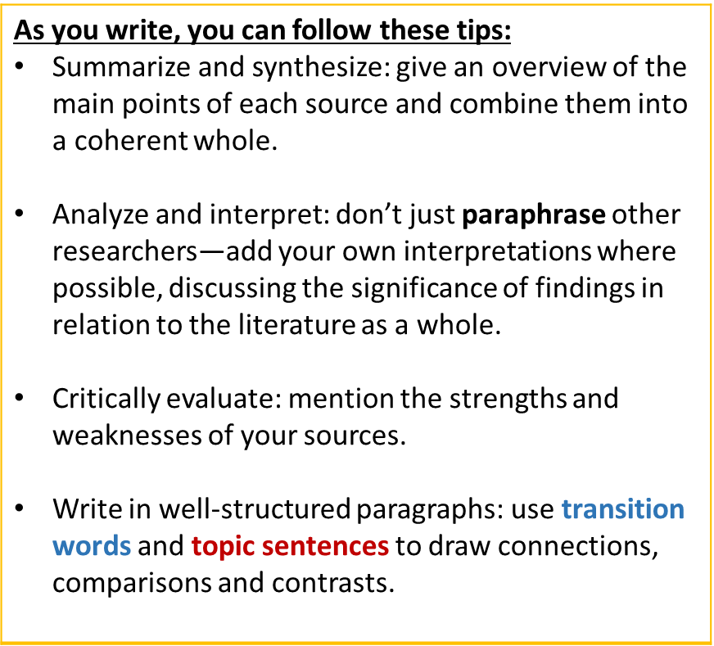
Step 5: Write your literature review
BODY

Slide 25
.
Let’s unpack how the following paragraph has been formulated using a topic sentence, transition words, evidence, critical evaluation and theory: Body image issues have been widely associated with social media usage, particularly in young women. The relation between media depictions and body image concerns is well-established; a meta-analysis by Grabe, Ward and Hyde (2008) concluded that exposure to mass media is linked to body image dissatisfaction among women. However, in an era of rapidly changing digital technologies, the mass media paradigm is no longer adequate for understanding how people engage with images, and the findings of older studies like this one may not be generalizable to younger generations. In light of this changing landscape, researchers have become increasingly interested in the specific effects of social media. Perloff (2014) theorizes that the interactive aspects of social media may influence its impact on body image, and mentions that young women are among the most active social media users. Several empirical studies have focused on Facebook usage in adolescent girls (Tiggermann & Slater, 2013; Meier & Gray, 2014) and in young adult women (Smith, Hames, & Joiner, 2013; Fardouly et al., 2015; Cohen, Newton-John & Slater, 2017), while a systematic review by Holland and Timmerman (2016) confirmed a relationship between social networking and body image for both women and men. Across these studies, there is consistent evidence that body image issues are influenced not by social media usage in general, but by engagement with the visual and interactive aspects of these platforms. Nonetheless, there is a lack of robust research on more highly-visual social media (HVSM) such as Instagram and Snapchat that have gained more recent popularity among younger generations.
. | Topic sentence – the first sentence establishes the main point of the paragraph.
. | Pivotal study – this sentence summarizes a pivotal publication in the field.
. | Critical evaluation – this sentence critiques a weakness of that study.
. | Theory – these sentences summarize a more recent theoretical perspective on the topic.
. | Synthesis – several empirical studies are synthesised to show a clear pattern of finding in support of the theory.
. | Gap – A gap in the literature is identified, making way for the relevance of the author’s own research.

Slide 26
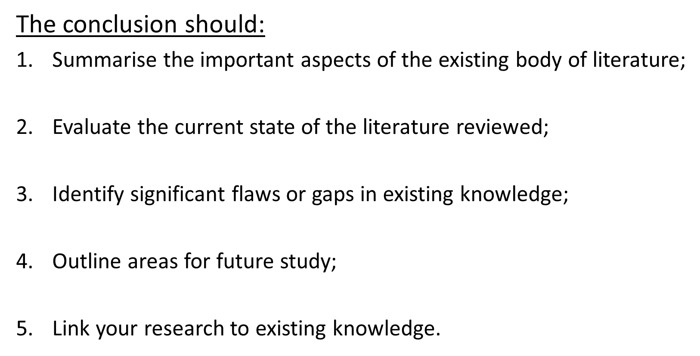
Step 5: Write your literature review
CONCLUSION

Slide 27
Step 5: Write your literature review
Dissertation literature review (as a chapter) If the literature review is part of your thesis or dissertation, show how your research addresses gaps and contributes new knowledge, or discuss how you have drawn on existing theories and methods to build a framework for your research. Stand-alone literature review If you are writing a stand-alone paper, you can discuss the overall implications of the literature or make suggestions for future research based on the gaps you have identified.

Slide 28
Additional notes
The entire point of writing a literature review is to synthesize, or write about the relationships between, the articles you’re using, defining the connection between them and explaining how they come together to represent a body of knowledge on a subject.
Linking words are important. These are also known as transitional or relational words and phrases. If you are grouping together writers with similar opinions, you would use words or phrases such as: similarly, in addition, also, again.
More importantly, if there is disagreement, you need to indicate clearly that you are aware of this by the use of linkers such as: however, on the other hand, conversely, nevertheless.
The following words and phrases are useful because they express specific types of relationships between ideas:

Slide 29
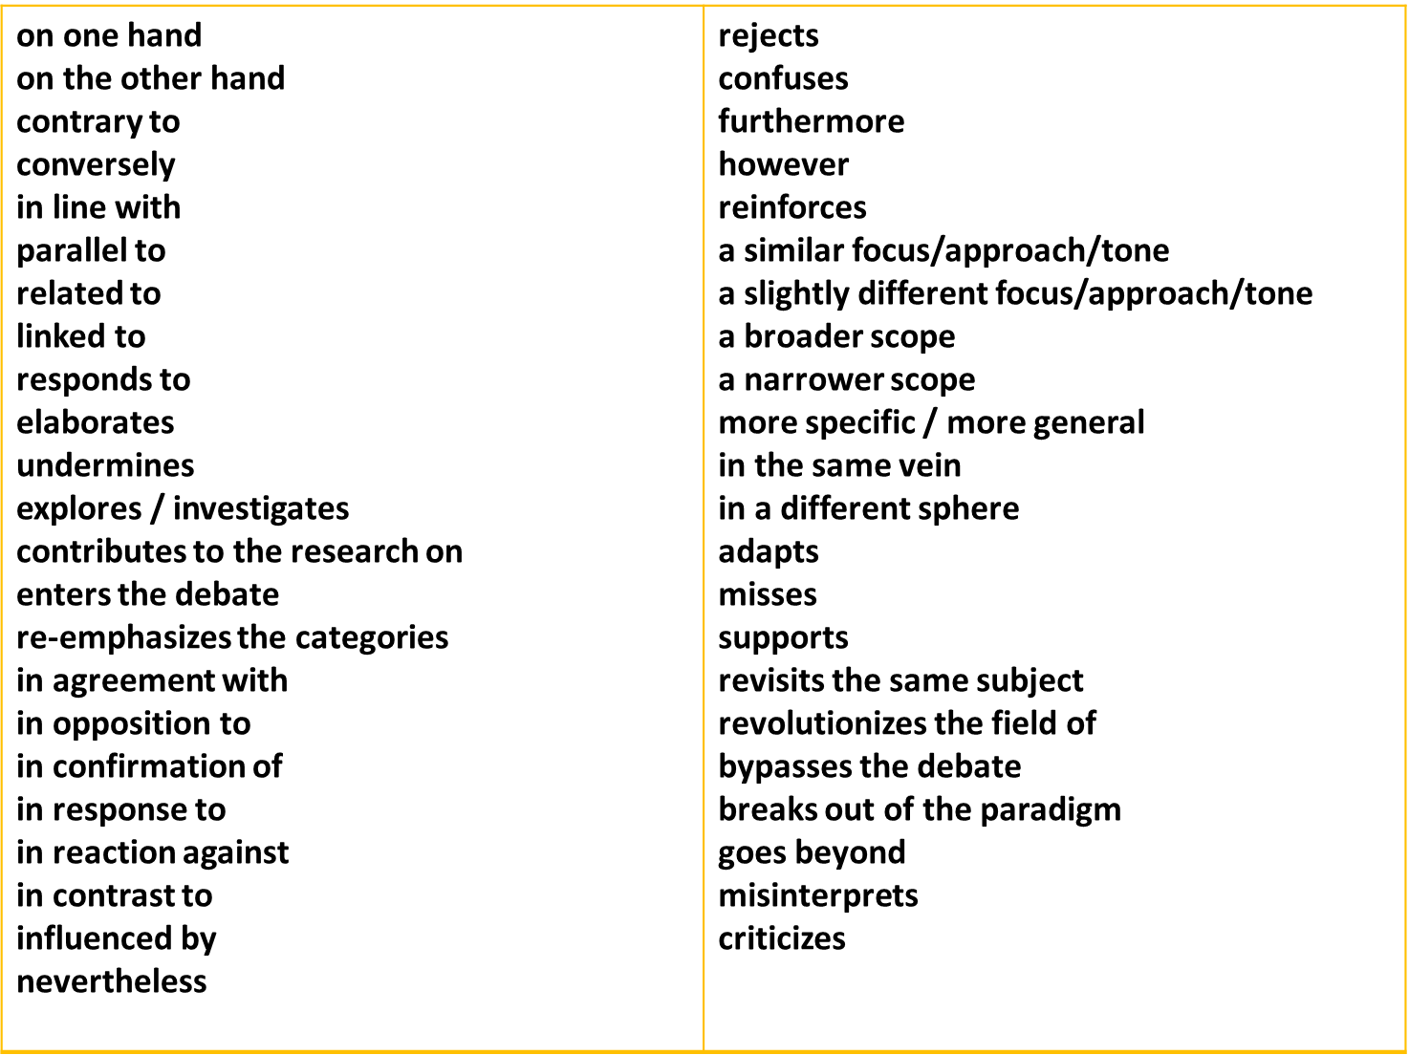
Examples of transitional words and phrases

Slide 30
Additional notes:
When you’ve finished writing and revising your literature review, don’t forget to edit and proofread thoroughly before submitting.
DO NOT PLAGIARISE. Use the referencing convention required by your lecturer/supervisor/faculty. Use the selected format consistently. We require you to use the Harvard Method of referencing. Refer to your Prof Comm 1 and Prof Comm 2 notes or follow the link below for CPUT’s quick guide to referencing:
https://www.cput.ac.za/storage/faculties/business/research/school_of_accounting/soa_harvard_reference.pdf

Slide 31
Additional notes – reviewing your review
Once you have a first draft of your literature review it is possible for you to assess how well you have achieved your aims:
One way of doing this is to examine each paragraph , and to write in the margin a very brief summary of the content of each, and the type of content e.g:
argument for - argument against – description – example - theory – link
These summaries then provide the outline of the story you are telling, and the way that you are telling it. Both of these are important and need to be critically reviewed.
Beware of becoming too attached to your writing. You need to be ready to cross out whole paragraphs or even whole sections if they do not pass the above tests.
If you find that what you’ve written is not in the best order, then re-shaping it is not a huge problem. It may be mainly a case of cutting and pasting material into a different order, with some additional explanation and linking. If this produces a more relevant and streamlined argument it is well worth the effort.

Slide 32
Reviewing your review – useful questions
What is the balance between description and comment?
Have I missed out any important dimension of the argument, or literature?
Have I supported the development of each step in my argument effectively?
Is the material presented in the most effective order?
Are there places where the reader is left with unanswered questions?
Is every element of my research question supported by the preceding material?
Have I explained to the reader the relevance of each piece of evidence?
Is there any material that is interesting but which does not contribute to the development of the argument?
Have I explained adequately the justification for this research approach / topic / question?
Are my references up to date?
How effective is my linking of all the elements?

Slide 33
Remember….
Use a narrative thread:
Although you clearly need to write in an academic style, it can be helpful to imagine that you are telling a story. The thread running through the story is the explanation of why you decided to do the study that you are doing.
The story needs to be logical, informative, persuasive, comprehensive and, ideally, interesting. It needs to reach the logical conclusion that your research is a good idea.
The aim is for the reader to reach the end of the literature review with a clear appreciation of:
what you are doing;
why you are doing it;
and how it fits in with other research in your field.

Slide 34
Links to sources:
https://www.scribbr.com/dissertation/literature-review/
https://www.vocabulary.com/dictionary/evaluate
http://www.ldoceonline.com/dictionary/evaluate
https://en.oxforddictionaries.com/definition/scholarship
http://dictionary.cambridge.org/dictionary/english/scholarship
https://ltl.lincoln.ac.nz/research/writing-a-literature-review/what-is-a-literature-review/
http://www.brooklyn.cuny.edu/web/aca_facultywac/Mini-Lessons-LiteratureReview.pdf
http://www2.le.ac.uk/offices/ld/resources/writing/writing-resources/literature-review
http://www.monash.edu.au/lls/llonline/writing/general/lit-reviews/index.xml

